Slide 1
Chapter 14 – S19
How to work with closures
Notes:
Session: Ghi số thứ tự session trong môn học
Session Name: ghi tên của session sẽ dạy

Slide 2
Objectives
Introduction to clousures
How to use clousures
The Slide Show application
How to use callbacks
How to use recursion
The Task Manager application
Notes:
Mô tả nội dung mà học viên phải đạt được khi kết thúc môn học này

Slide 3
How to use closures
Notes:
Session: Ghi số thứ tự session trong môn học
Session Name: ghi tên của session sẽ dạy

Slide 4
How the scope chain works
The scope chain in JavaScript refers to what is in scope, or what can be seen and used by other objects.
The scope chain starts with global scope and move down.
Object that are created within other objects have access to their own sope, and the sope of the object that contains them.

Slide 5
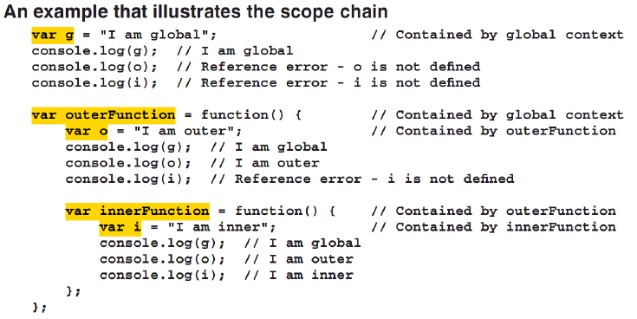
Scope chain example

Slide 6
Introduction to closures
Closure is a function which is created in another function(parent function). It can access the object in parent function even the parent function has finished executing and is out of scope.
Clouse are a powerful feature of JavaScript language and they are common used in many framework.

Slide 7
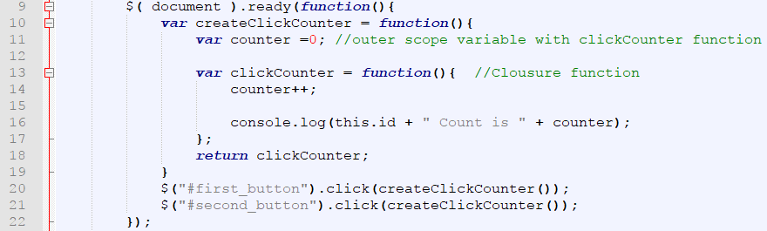
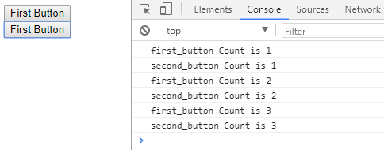
How closures work
An example that illustrates a closure
Result in console when you click on buttons
Notes:
Closures là một function được tạo ra trong môt function khác (chức năng cha). Nó có thể truy cập đối tượng trong hàm cha ngay cả hàm cha đã thực hiện xong và nằm ngoài phạm vi.

Slide 8
How closures work (cont.)
When we click a button, look at return statement in line 18, it call clickCounter function. In this time the createClickCounter was finish but clickCounter function still can access counter variable in this function.
Look at the result in console, it can separate the counter variable private for each event handler. It is advanced of closure.

Slide 9
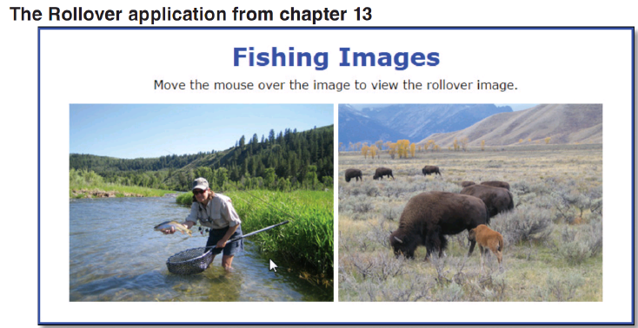
Closures in the Rollover application

Slide 10
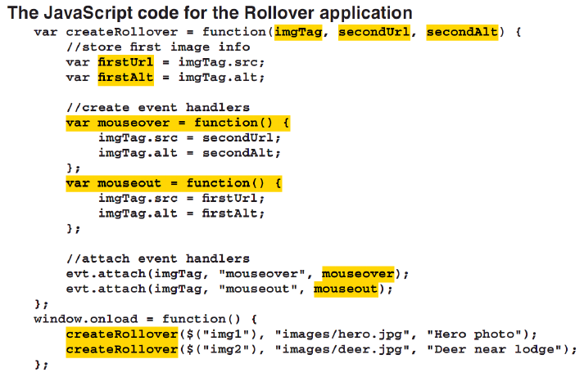
Closures in the Rollover application

Slide 11
Objectives
An introduction to JSON
How to work with JSON in JavaScript
The Task Manager application
How to customize stringify method
How to customize parse method
The enhanced Task Manager application
Notes:
Mô tả nội dung mà học viên phải đạt được khi kết thúc môn học này

Slide 12
An introduction to JSON
Notes:
Session: Ghi số thứ tự session trong môn học
Session Name: ghi tên của session sẽ dạy

Slide 13
The serialize and deserialize
When you want to send an object across network, you must convert them to the data then send the data over network. This process called serialize.
The application read the data to render an object. This process is called deserialize.
Only object’s data is serialized, not its method.

Slide 14
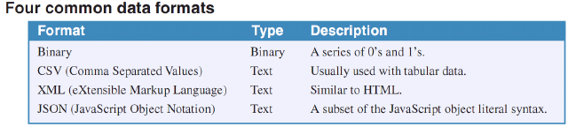
How data formats work
There is many way to data formats is used to serialize objects.

Slide 15
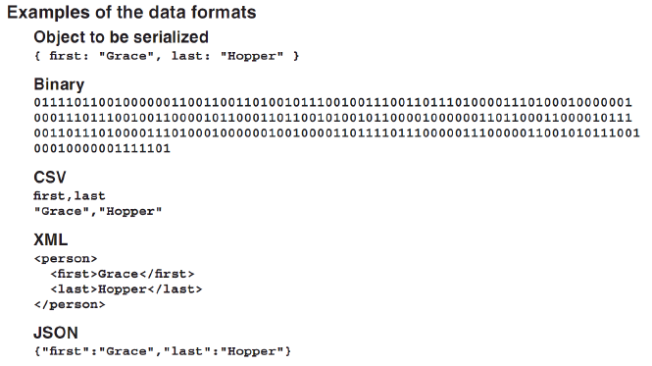
How data formats work (cont.)

Slide 16
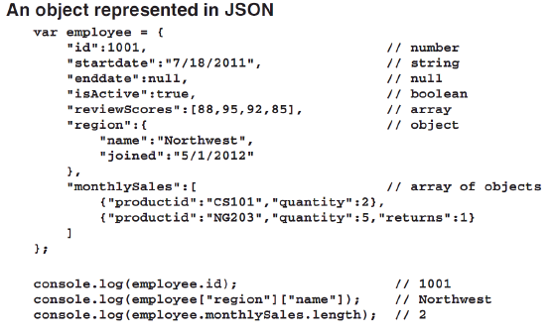
What JavaScript Object Notation (JSON) is
JSON is a data format for transferring and storing data that works especially well with JavaScript application.

Slide 17
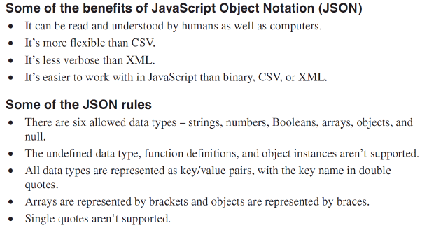
What JSON is (cont.)

Slide 18
How to work with JSON in JavaScript
Notes:
Session: Ghi số thứ tự session trong môn học
Session Name: ghi tên của session sẽ dạy

Slide 19
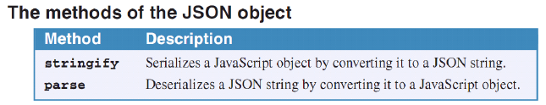
An introduction to the global JSON object
All modern browsers have a global JSON object that provide stringify and parse methods for working with native JSON objects and JSON strings.

Slide 20
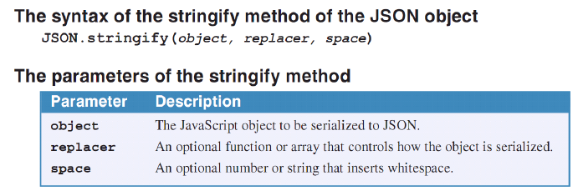
How to use stringify method of the JSON object
The stringify method of the JSON object converts the JavaScript object that’s passed to it to a JSON string.

Slide 21
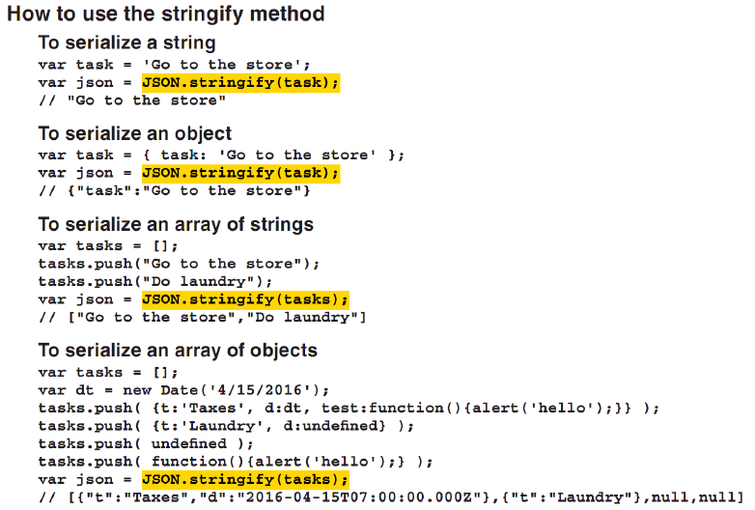
How to use stringify method of the JSON object (cont.)

Slide 22
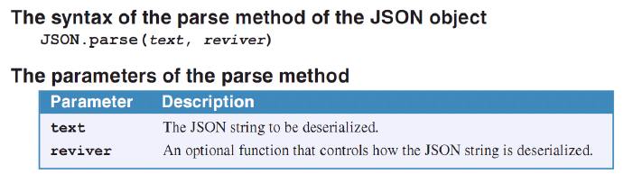
How to use parse method of the JSON object
The parse method of JSON object converts a JSON string to a JavaScript object.

Slide 23
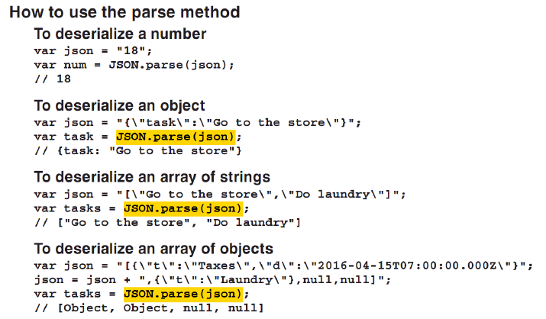
How to use parse method of the JSON object (cont.)

Slide 24
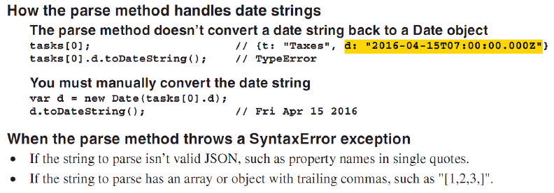
How to use parse method of the JSON object (cont.)

Slide 25
The Task Manager application
Notes:
Session: Ghi số thứ tự session trong môn học
Session Name: ghi tên của session sẽ dạy

Slide 26
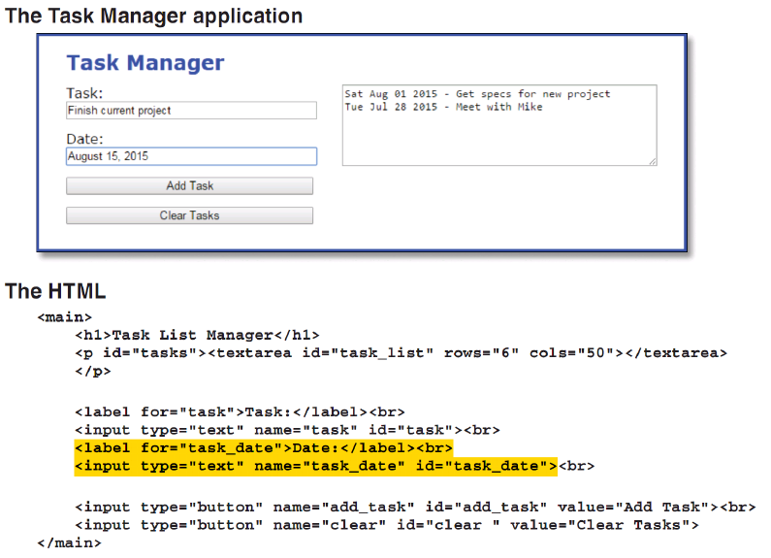
The Task Manager application

Slide 27
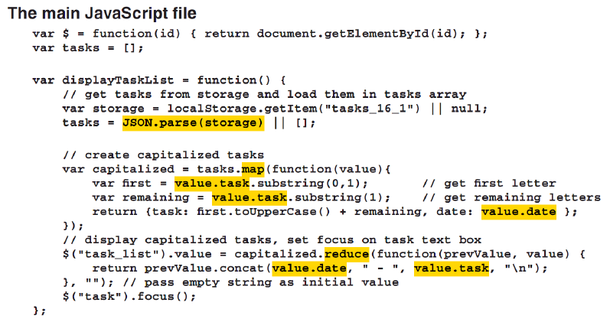
The Task Manager application (cont)

Slide 28
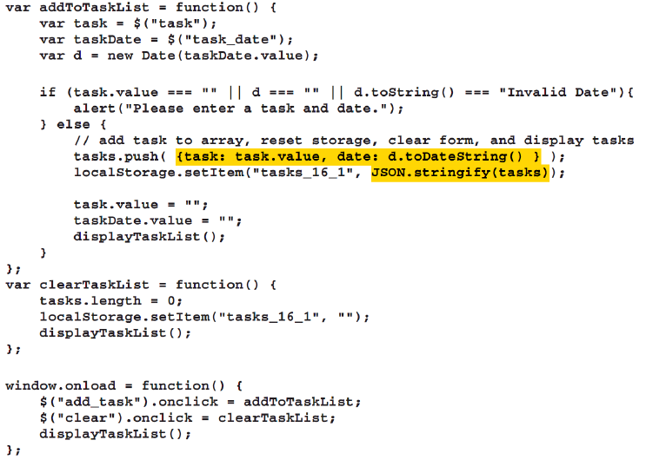


Slide 29
How to customize the stringify method
Notes:
Session: Ghi số thứ tự session trong môn học
Session Name: ghi tên của session sẽ dạy

Slide 30
How to use the toJSON method
One way to customize the resuls of the stringify method is to add a toJSON method to the object being to serialize.
When you might use the toJSON method
To combine two or more properties.
To add to the serialization output
To keep properties from appearing in the serialization output.

Slide 31
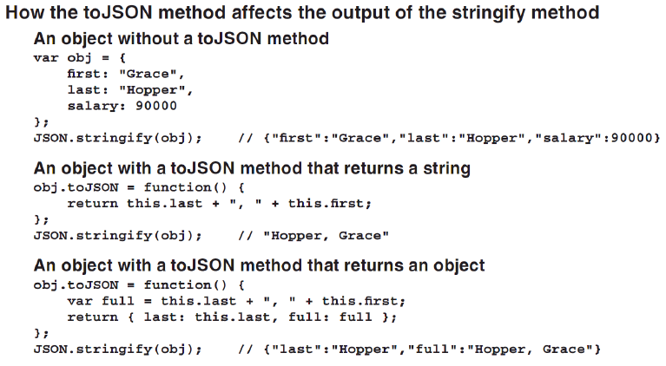
How to use the toJSON method (cont.)

Slide 32
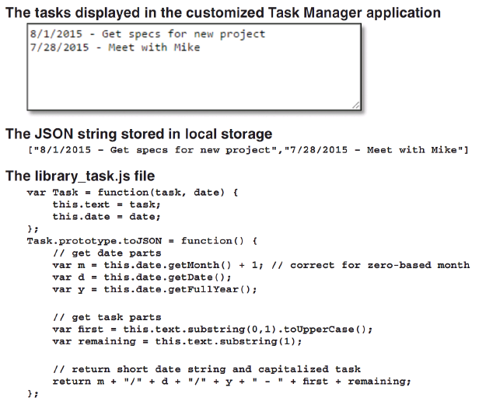
How to use the toJSON method to customize the Task Manager application

Slide 33
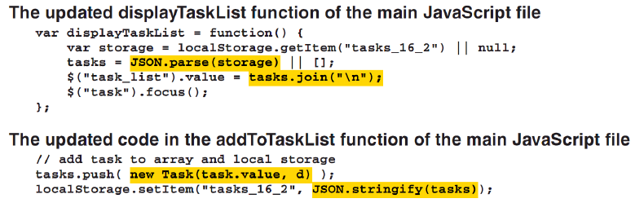
How to use the toJSON method to customize the Task Manager application

Slide 34
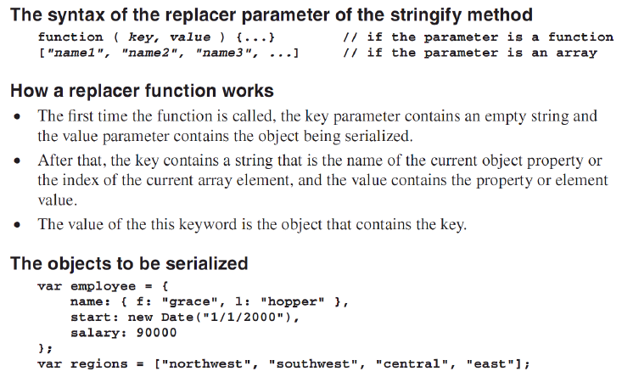
How to use the replacer parameter of the stringify method

Slide 35
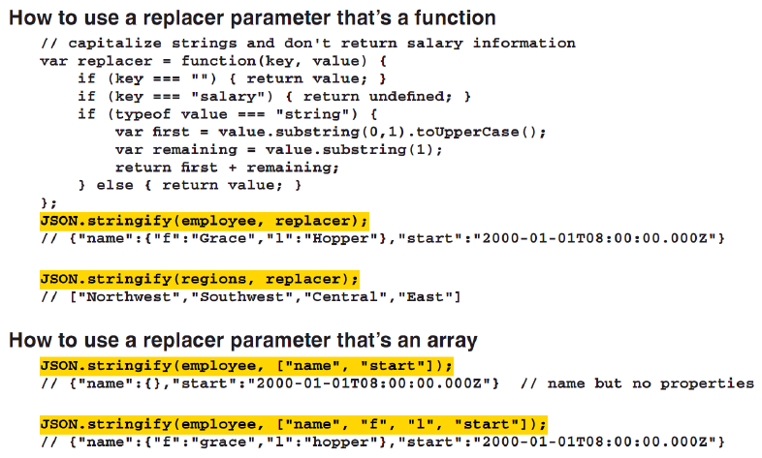
How to use the replacer parameter of the stringify method (cont.)

Slide 36
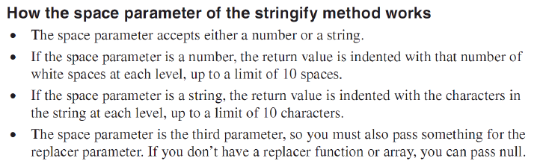
How to use space parameter of the stringify method
The JSON string returned by the stringify method has no white space, its make difficult to read. In some cases, you can use the space parameter of the stringify method to format the way the JSON string look.

Slide 37
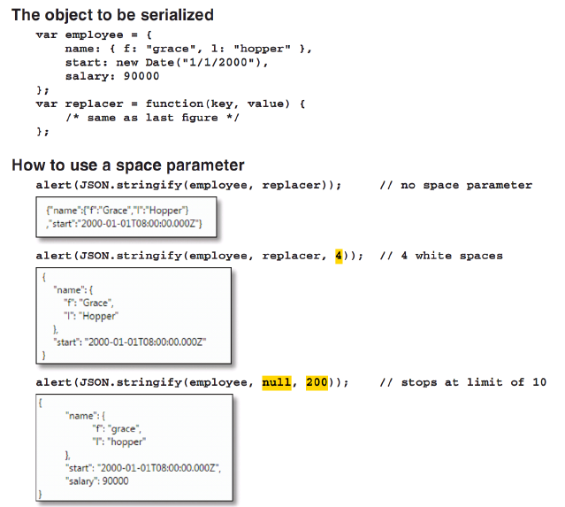

Slide 38
How to customize the parse method
Notes:
Session: Ghi số thứ tự session trong môn học
Session Name: ghi tên của session sẽ dạy

Slide 39
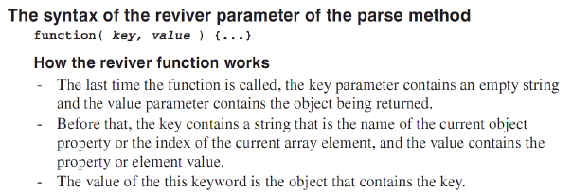
How to use the reviver parameter of the parse method
The optional reviver parameter of the parse method is a function that’s called on every object property or array element. This lets you control the deserialization.

Slide 40
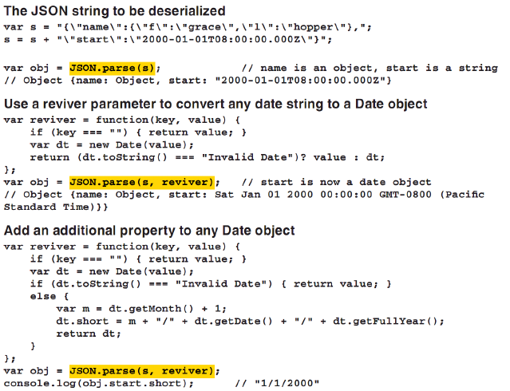
How to use the reviver parameter of the parse method (cont.)

Slide 41
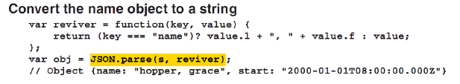
How to use the reviver parameter of the parse method (cont.)

Slide 42
The Enhanced Task Manager application
Notes:
Session: Ghi số thứ tự session trong môn học
Session Name: ghi tên của session sẽ dạy

Slide 43
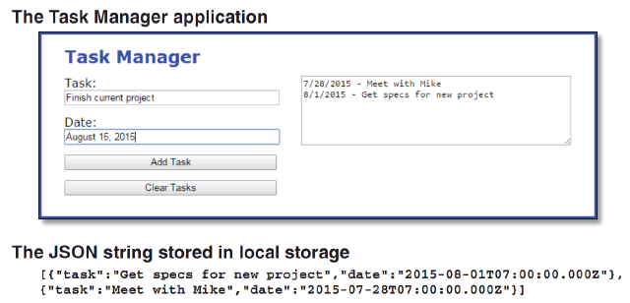
The Interfaces

Slide 44
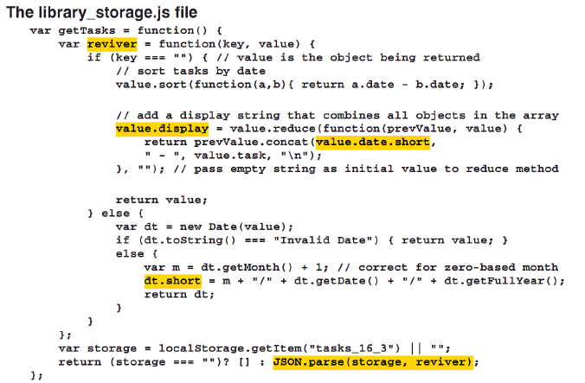
The storage library

Slide 45
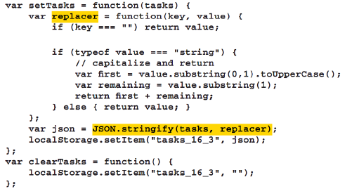
The storage library (cont.)

Slide 46
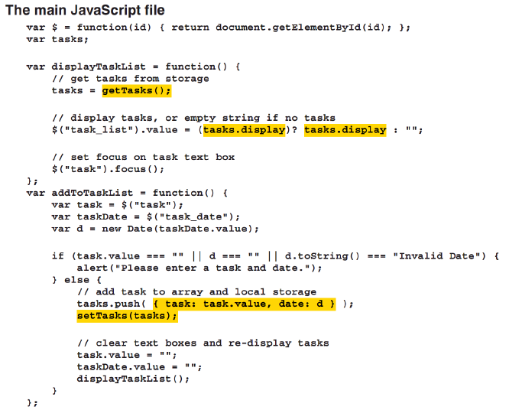
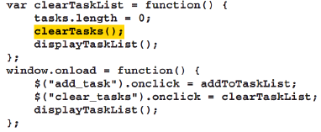
The main JavaScript file

Slide 47
Summary
When you want to send an object across network, you must convert them to the data then send the data over network. This process called serialize.
The application read the data to render an object. This process is called deserialize.
There is many way to data formats is used to serialize objects like binary, csv, XML, JSON.
JSON is a data format for transferring and storing data that works especially well with JavaScript application.
All modern browsers have a global JSON object that provide stringify and parse methods for working with native JSON objects and JSON strings.
Notes:
Tóm tắt lại nội dung đã học

Slide 48
The End.

